Slide 1
AMR Project

Slide 2
Main idea
Collect some objects in the environment to a certain place

Slide 3
Tasks
Build environment and robot structure
Detect objects
Motion planning

Slide 4
Strategy
Get the position and shape information of objects
Let the robot go on the same line of the target place and the object, then go straight back to the target place
Control the angle along the way

Slide 5
Technique
Mapping
A-star algorithm
PID control

Slide 6
Mapping
(-500,500)
column
y
row
y
(-0, 0)
x
Occupancy grid map
Lidar Position Grid Index
Passive method for controlling when building map
Keyboard control
(-x, y)
x

Slide 7
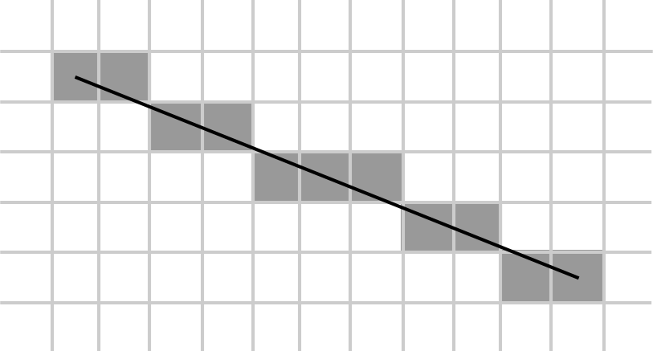
Mapping
Bresenham’s line algorithm
(scikit-image)
Log-odd update
Case 1: cells with z = 1
log odd += log odd_occ
Case 2: cells with z = 0
log odd -= log odd_free

Slide 8
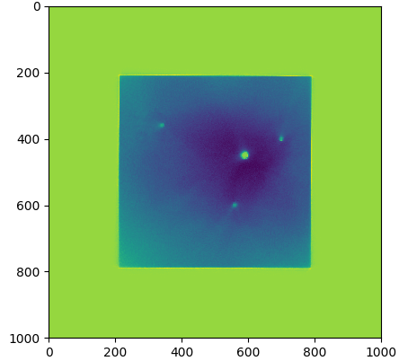
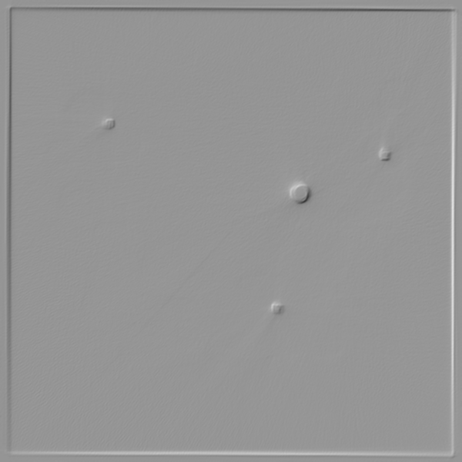
Mapping
Numpy Array Image
gradient

Slide 9
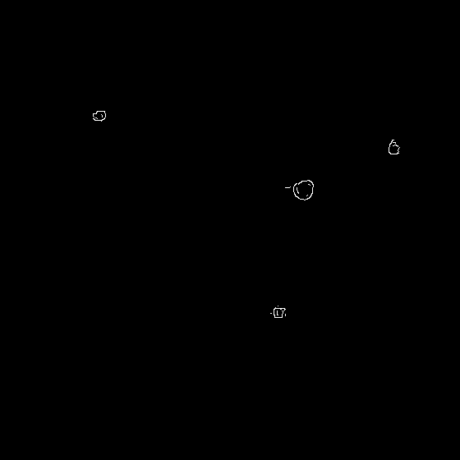
Mapping
Normalization
Canny edge detector
OpenCV

Slide 10
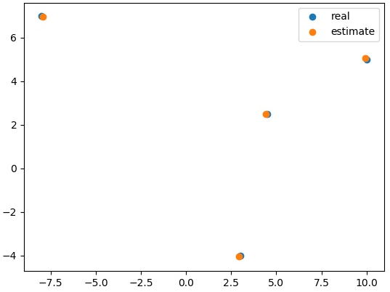
Mapping
K means to find obstacle midpoints
Error is less than 3 grids
(resolution is 0.05)

Slide 11
Results

Slide 12
Conclusion

Slide 13
Thank you!

